Slide 1
Notes:
Facilitator Notes:
1. Use as a place holder for the Webinar as people join – then turn off your screenshare as you start so people can see you!
Start Up Instructions
Trainer: Log in to Zoom using the zoom@gfelstewards.co.uk and start the session from the webinar menu – the webinar will start in practice mode
The Trainer is now the host for the session – and the session opens in practice mode so only trainers and panelists are admitted
Promote all other panelists to co-hosts by opening the “participants” tab, mouse over names – select “more” and select promote to co-host
Activate live captioning by selecting “live transcript” (could be listed under the “more” button”) and enable “live transcription” or “auto transcription” (only the host can do this)
When ready, make the session live (hists or co-hosts can do this) by clicking the blue button at the top – probably 2 or 3 minutes before the session start time. At this point attendees will be able to join the session and hear and see you! You could always ask them to tell us where they are from in the chat!
All areas do need to be covered but the pace of learning is key, should be quick paced throughout but spend extra time where needed and as appropriate to the group’s needs.

Slide 2
Welcome
DO NOT SHARE SCREEN TRAINER NOTES ONLY
Notes:
Facilitator Notes:
Introduce yourself and your team for the training
Explain that the only people who will have their cameras on and will be talking are the facilitators
Ask participants to ask any questions using the Q&A button
Any helpful hints and tips can be shares using the chat function
The session is being recorded and any questions that haven’t been answered during the session will be taken away and (hopefully) answers shared via the Oxfam Stewards website
Please remember all participants and facilitators can see all questions and chat comments – please be respectful to each other at all times
HIGHLIGHT: this is general steward training – we will not be able to answer any specific festival questions
Check how many have stewarded for Oxfam before – thank them for returning. Explain we know some of this will be second nature to you now, but its important to refresh your training as it does change year on year. Its also great for new stewards to meet experienced stewards so please do say hello to each other.
Anyone new to stewarding – welcome & thank you
Everyone has something to offer - Even if you have only been camping on holiday, it’s useful experience!
Life experience and common sense valuable
Thank people for volunteering - but point out we consider them professionals. That isn’t about payment, though they do have a highly sought after position, and raise hundreds and thousands of pounds this summer for Oxfam. It’s about the professional attitude, as they are a key part of putting on the Festival – as stewarding is a condition of the Licence it literally could not happen without them.

Slide 3
SESSION OUTLINE
What is Stewarding?
Roles and Responsibilities
Being on Shift
Keeping Safe
Casualties & Reporting Medicals
Emergencies
Using Radios
Lost & Found Children
Disability Awareness
Notes:
Facilitator Notes:
Topic: Event Outline
Key Message: – We have high expectations of our stewards, we have delivered year on year, and want improvement year on year.
Associated handouts/resources: None
Briefly explain structure of session, emphasis on equipping them with the essentials for being an effective steward –
Whilst also giving them useful life skills to take away – e.g. Reacting to a medical emergency
3. The key things they must know / should know /could know
4. Will always be learning something new

Slide 4
Where we are this year:
Bearded theory – download
Isle of wight – Glastonbury
NASS – 2000 trees
Latitude - WOMAD - WILDERNESS
BOARDMASTERS - Boomtown
BEAUTIFUL DAYS – Arctangent
LEEDS – READING - shambala
16 festivals and events
7500 volunteer spaces
16 EVENTS CLOSE TO 5000 STEWARD PLACES
Notes:
Topic: Where we are this year
Associated handouts/resources: None
Facilitator Notes
Need more volunteers for Boomtown, IOW, 2000 Trees and ArcTanGent

Slide 5
STEWARDS
SHOPS
CAMPAIGNS
Notes:
Topic: Oxfam Festivals Teams
Associated handouts/resources: None
Facilitator Notes
Highlight that stewarding is one part of the Festivals team and that at many festivals Oxfam will also have campaigners (campaign details TBC) and shops all working to raise awareness and money for Oxfam

Slide 6
WHAT IS STEWARDING?

Slide 7
Oxfam Stewards
The Gold Standard
Friendly
Informed
Professional
Smiling
Representing Oxfam and the festival
Notes:
Topic: An Oxfam Steward
Associated handouts/resources: None
Facilitator Notes
Express importance of the fact we have gained our position in the industry for being friendly and informed.
Thank them for being part of this and a representative of Oxfam
Highlight it could be their attitude that makes or breaks our level of service at that event.

Slide 8
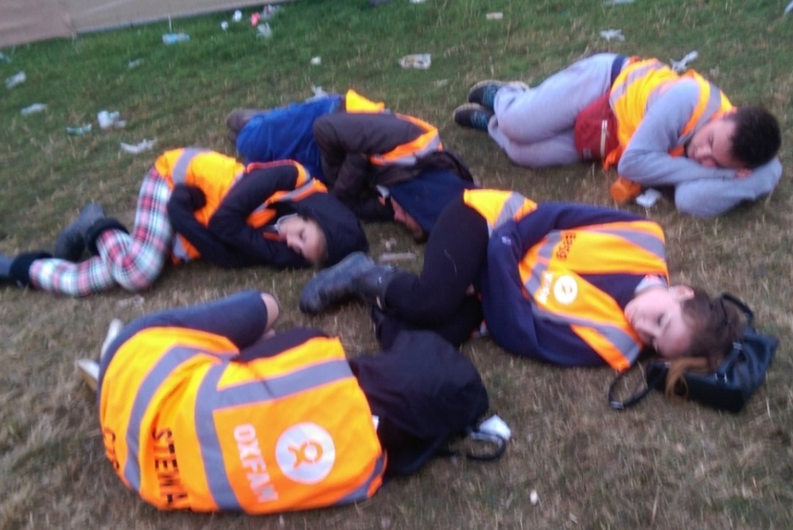
NOT an Oxfam Steward…
We want you to have fun stewarding with us, but we do expect you to uphold our standards of behaviour
If you don’t we have to power to evict and withdraw your access to volunteering in the future
REMEMBER: You are a key representative of Oxfam
Notes:
Topic: Not An Oxfam Steward
Associated handouts/resources: none
Facilitator Notes:
Express importance of the fact we have gained our position in the industry for being friendly and informed.
You will have agreed to our standards of behaviour in the terms of reference and code of conduct when you applied – please ensure you have read and understood both of these documents
This photo was taken at a festival and then anonymously emailed to us. So people do take notice and it’s our reputation that’s on the line.

Slide 9
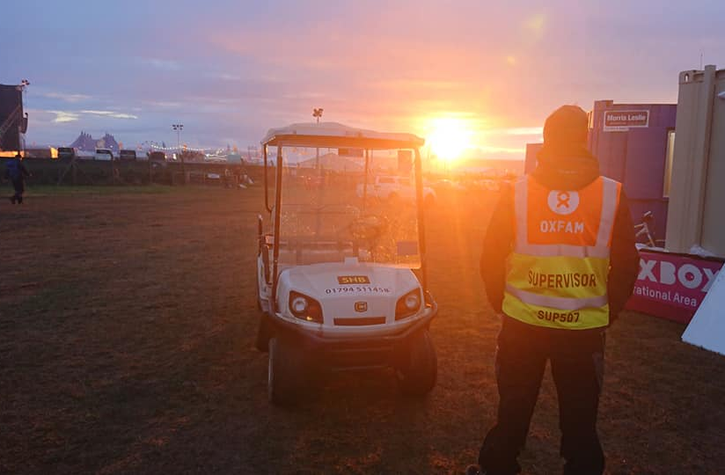
Steward Supervisors
Manage teams
Point of contact
Allocate breaks
More supervisors are always needed – why not give it a go?
Notes:
Topic: Steward Supervisors
Associated handouts/resources: none
Facilitator Notes:
The supervisors oversee teams of stewards in the different areas across site; campsites, gates, music tents and stages - and any other key areas of the festival site.
The role of a supervisor is varied - supervisors can be located in a static position with their stewarding team, or they can be responsible for a wider area with stewards at multiple locations.
The different elements of a Supervisors role are:
They will be the first port of call for questions from their group of stewards.
They will manage the positioning of their stewards to ensure all locations are covered and all stewards are allocated breaks.
They will be in regular communication with Stewards Control (Oxbox) to report issues or receive instructions.
If you’re interested in becoming a supervisor please contact the Stewarding Office (we have 2 supervisor training sessions taking place in April – get in touch with office)

Slide 10
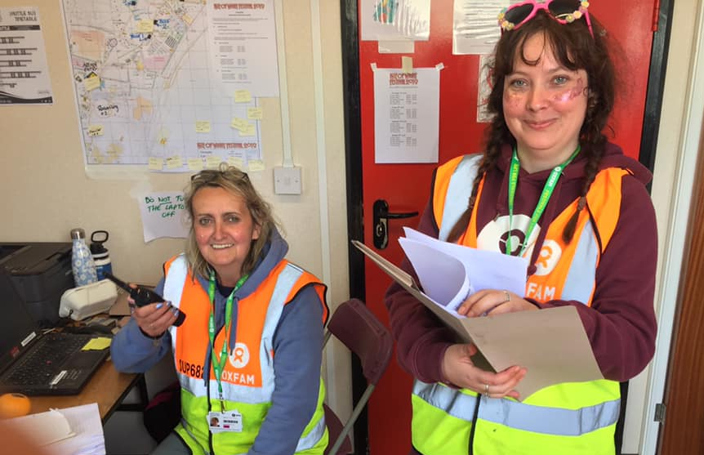
Shift Leading Team
Run the shift
Communicate with coordinators
Inter-agency communication
Log radio calls
Point of contact for issues
Notes:
Topic: Shift Leading Team
Associated handouts/resources: none
Facilitator Notes:
Shift Leaders are stationed in Steward Control (Oxbox) or Comms and are responsible for the smooth running of each shift,
Please emphasise: The Oxbox, our onsite base.
Shift Leaders have a Deputy Shift Leader and up to 5 people to assist them and are responsible for:
Monitoring staffing (including supervisors) levels at all locations.
The Health & Safety and Welfare of all stewards on shift.
Liaising with the festival organisers
Ensuring emergency situations are immediately communicated to relevant agencies.
Ensuring all communication and radio traffic is recorded.
Important to emphasise;
They are the First port-of-call for questions unless otherwise advised in your stewards briefing.
((for trainers info only - Because at some festivals there will be an Adbox, separate administration office for them to report to for questions, freeing up operational space and time))

Slide 11
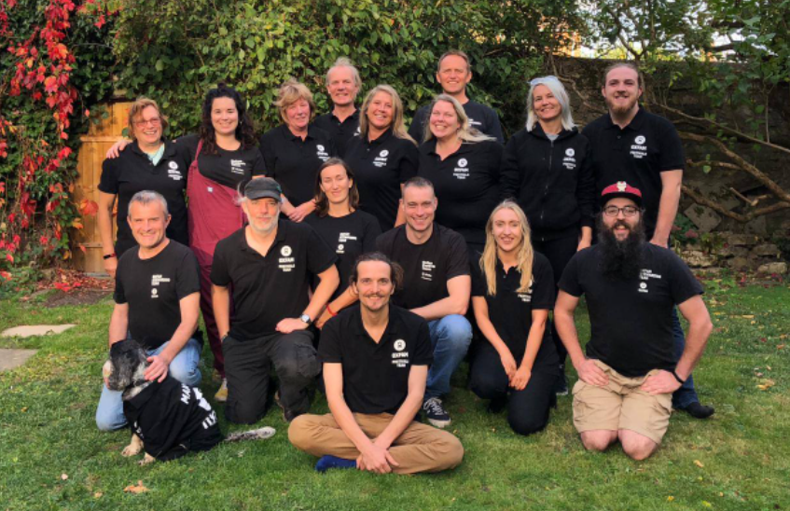
Coordinators
Responsible for the welfare and safety of all volunteers and staff on site
Point of contact between festival management & Oxfam

Slide 12
STEWARDING ROLES & RESPONSIBILITIES

Slide 13
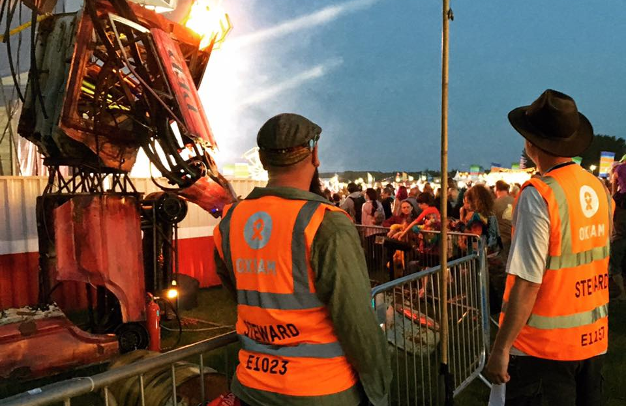
Roles & Responsibilities
Looking after the public
Eyes and ears of the festival
Ensure a safe environment
Monitor and report on incidents and hazards
Support other agencies as required
Notes:
Topic: Stewarding Roles & Responsibilities
Associated handouts/resources: none
Facilitator Notes:
Start by saying: All roles are different. You will find out on site. And don’t worry, you will have opportunity to swap shifts etc. if necessary!
Roles can range from a medical incident needing a first aid to overcrowding in an area.
Facilitator Notes:
The primary role of stewarding is: Looking after the public. By giving information & monitoring & reporting of issues.
Emphasize the role is all based on the professional approach previously described and that will inform common sense. At all times remember they are the public face of Oxfam and the Festival and the interactions they have will affect the public experience; for good or bad.
Importance of reporting hazards and incidents, even if they are off duty in which case they should find the nearest steward or supervisor.
We work alongside security. Only they can lay hands on people, go through bags etc. If somebody jumps on a stage it is security who gets them off, not stewards.
Stewards are not there to watch equipment for performers or look after festival goers’ children or belongings.
Steward teams are a critical part of the Festival’s responsibility to deliver a safe event and meet the terms of their licence. Without us there could be no Festival.
And end with the following;
Always know where to direct someone for an answer if you don’t know the answer. Never just ‘I don’t know, sorry’

Slide 14
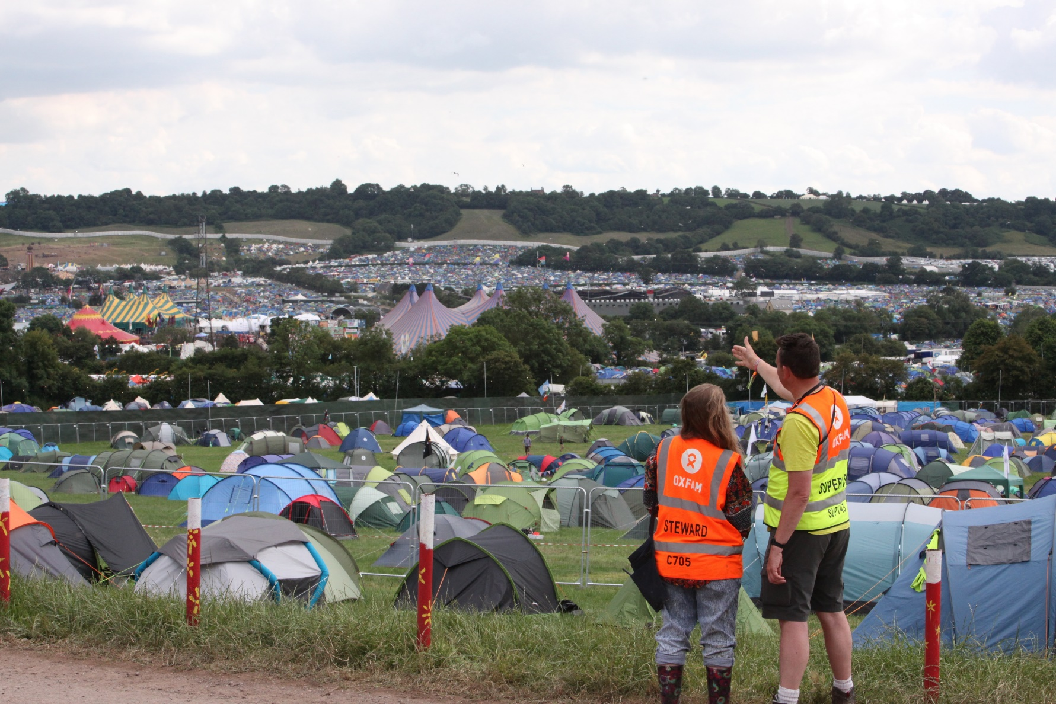
Campsites
Notes:
Topic: Campsite Stewards
Associated handouts/resources: none
Facilitator Notes:
*Before going into this section, mention there will be role descriptions posted up in the marquee at each festival, explaining in more detail what your specific roles & responsibilities will be on shift at that festival
Patrolling the campsite by foot
Ensuring any fire lanes or emergency routes are always clear
Acting as a focal point within the camping areas for festival goers and providing information to them as requested
Directing new festival-goers to the most appropriate camping areas
Reporting on availability and density of camping areas
Remaining vigilant for prowlers and potential cases of theft, vandalism, violence and illegal trading or sound systems
Staffing campsite info points
Campsite roamers
Please say at the end;
And of course you would be expected to work closely with the local campsite security teams.

Slide 15
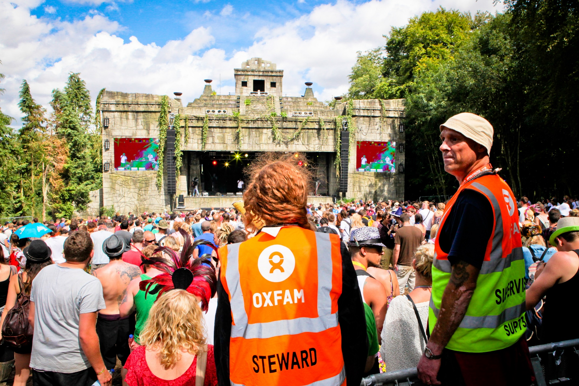
Venues
Notes:
Topic: Venue Stewards
Associated handouts/resources: none
Facilitator Notes:
Venue Stewards
Keep entrances & exits clear
Monitor crowd dynamics. Identify areas of possible overcrowding – We’ll talk about this later.
Be aware of crowd safety at all times
Know the location of fire extinguishers
Dissuading members of the public from climbing any structures
Assisting with evacuations
Top tips for venue stewards
Know the line-up
Be aware of the “no smoking” policy
Never stand directly in front of speaker

Slide 16
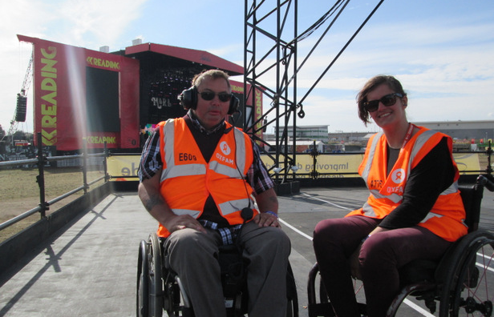
Viewing Platforms
Notes:
Topic: Accessible Viewing Platforms
Associated handouts/resources: none
Facilitator Notes:
There are VP’s at the main stages at most festivals.
We ask stewards with experience of working with people with disabilities and access requirements to steward our viewing platforms, but this is not essential.
Anyone wanting to use the platforms must have registered in advance of the festival to do so. They will be issued with VP ID for themselves and for one accompanying person. – Usually a wristband or laminate

Slide 17
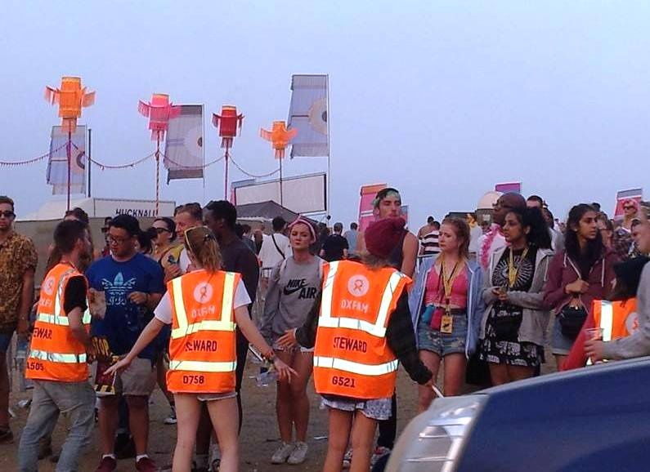
Pedestrian Crossing/Car Parks
Notes:
Topic: Pedestrian Crossing and Car Park Stewards
Associated handouts/resources: none
Facilitator Notes:
Ensuring the safety of pedestrians.
There will be a small number of festivals this year where we will be involved in car parking. You will get training for this on site.
You will never be asked to work on public highway.

Slide 18
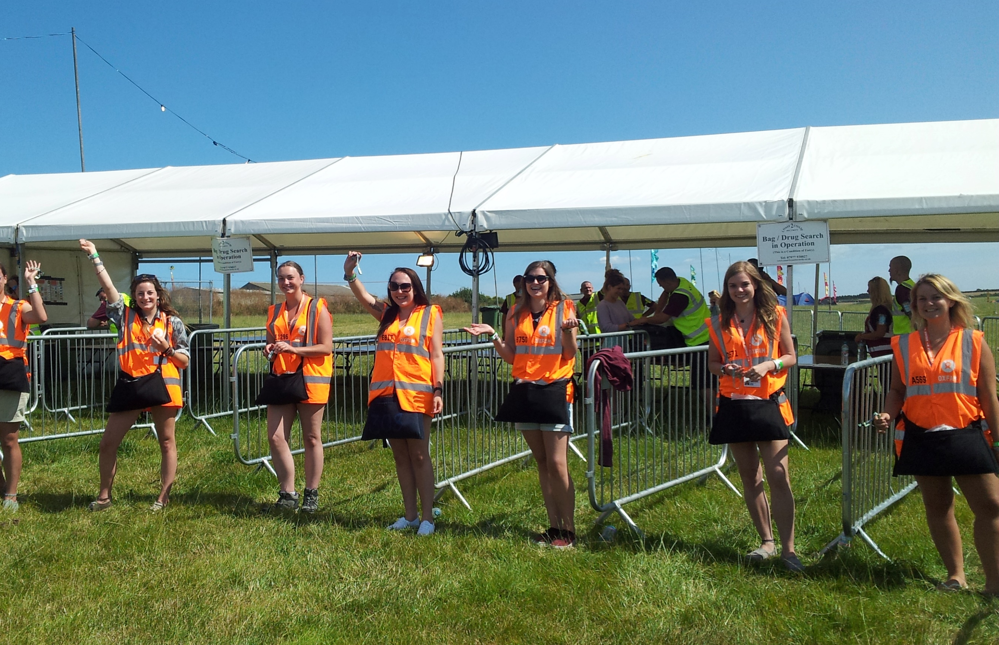
Gates
Notes:
Topic: Gate Stewards
Associated handouts/resources: none
Facilitator Notes:
There are two main types of gate you will be working at – a Pedestrian gate, dealing with flows of people & a Vehicle gate dealing with flows of vehicles.
We don’t need to go into too much detail on the work as it will be covered in on site briefing, but the role is outlined as follows;
Pedestrian
Ticket checking – be aware of all different ticket types and wristbands available
Wristband checking – be aware of the different wristbands. Please emphasise here, You will normally be expected to check the wristbands are tight and not tampered, give a quick tug to check (please do an example of this action)
Direct people without valid passes to other routes
Ensure that people cannot easily push past whilst checking other passes
Vehicle
Checking for valid vehicle passes
Ensure safe and fast easy access for emergency vehicles
Please emphasise:
Do not act as a door-person; if someone pushes past, contact your supervisor/radio for help with a clear description of the person.
Do not carry out searches or confiscations, this is for security

Slide 19
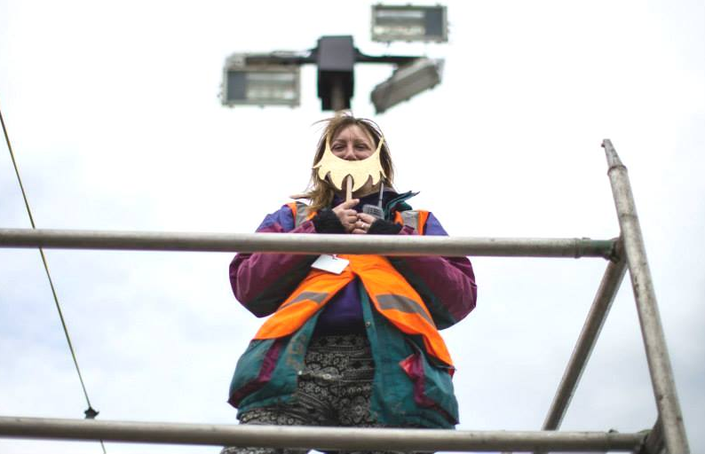
Fire Towers
Notes:
Topic: Fire Towers
Associated handouts/resources: none
Facilitator Notes:
At some festivals we man fire towers.
You can opt in to this role when you apply.
You can opt out on site if you have a real issue with heights.
You will be responsible for spotting fires in the campsite.

Slide 20
Wristband Check
Notes:
Topic: Pedestrian Gate Stewards
Associated handouts/resources: none
Facilitator Notes:
Some festivals ask you to double check the wristband hasn’t been tampered with, cut-off and put back together with sellotape etc.

Slide 21
Trainers attention test
1
2
3
4
5
6
7
8
9
10
11
12
Notes:
FACILITATORS:
This is to make sure that participants complete all of the training. There are 3 points in the presentation when they need make a note of the picture that’s shown, and then input it as an answer in the evaluation form. This is the first (make a note of which slide you’re used).
This is a navigation slide, designed to help you easily jump around this section of the presentation. In presentation mode, click any numbered square and the presentation will move to that slide. Once you’ve shown the image slide, click the number “1” in the bottom right hand corner to return to this slide.
Explain to participants:
This is an attention test, to make sure you are all still participating in the course
You need to carefully note the image you are seeing as you will need to enter it into the evaluation form using a drop down menu
If your answers are wrong in the evaluation form, you may receive a follow up call from the Steward Coordination Team to discuss

Slide 22
BEING ON SHIFT

Slide 23
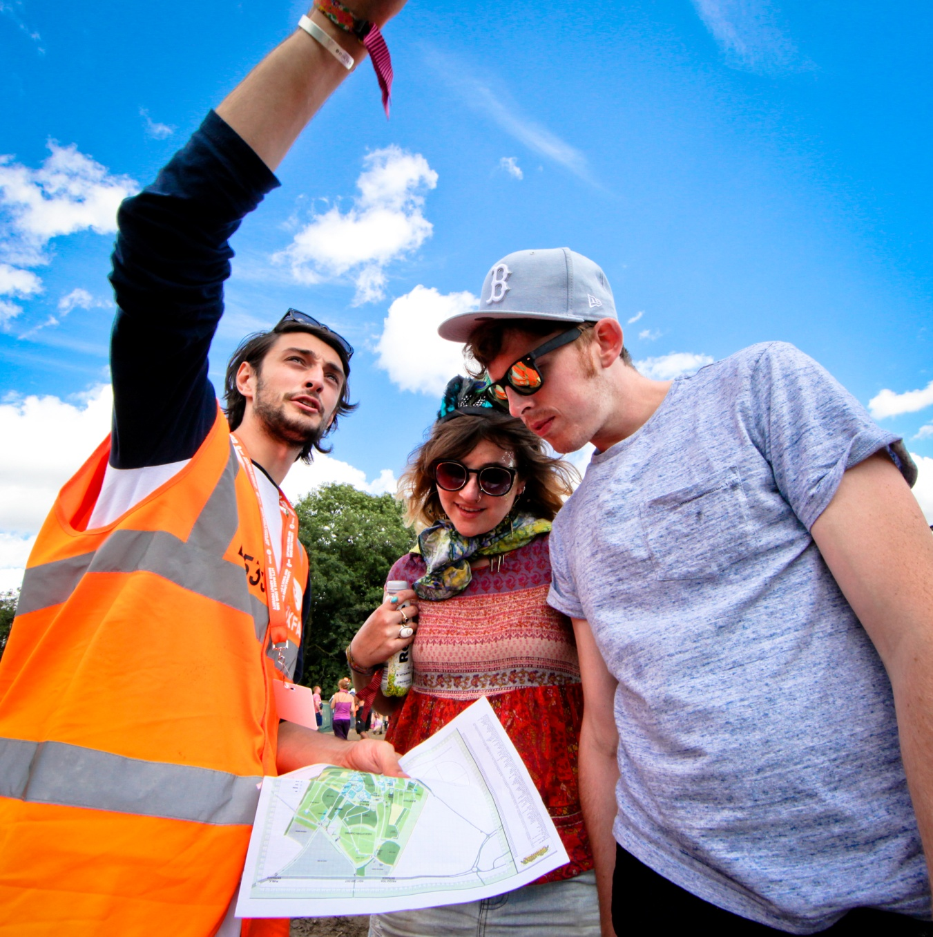
Get to Know the Festival
Explore
Identify your position
Work out your route/s to shift
Always carry your map
Know the importance of grid references
Notes:
Topic: Get to Know the Festival
Key Message:
Associated handouts/resources: Large Map of Area
Facilitator Notes:
At all events you will receive a gridded map of the site
You must carry this with you at all times
Identify your stewarding positions
Explore!
Familiarize yourself with your area
Familiarize yourself with the site
Understand grid references
Briefing areas/muster points
Fire points
Toilets
Water points

Slide 24
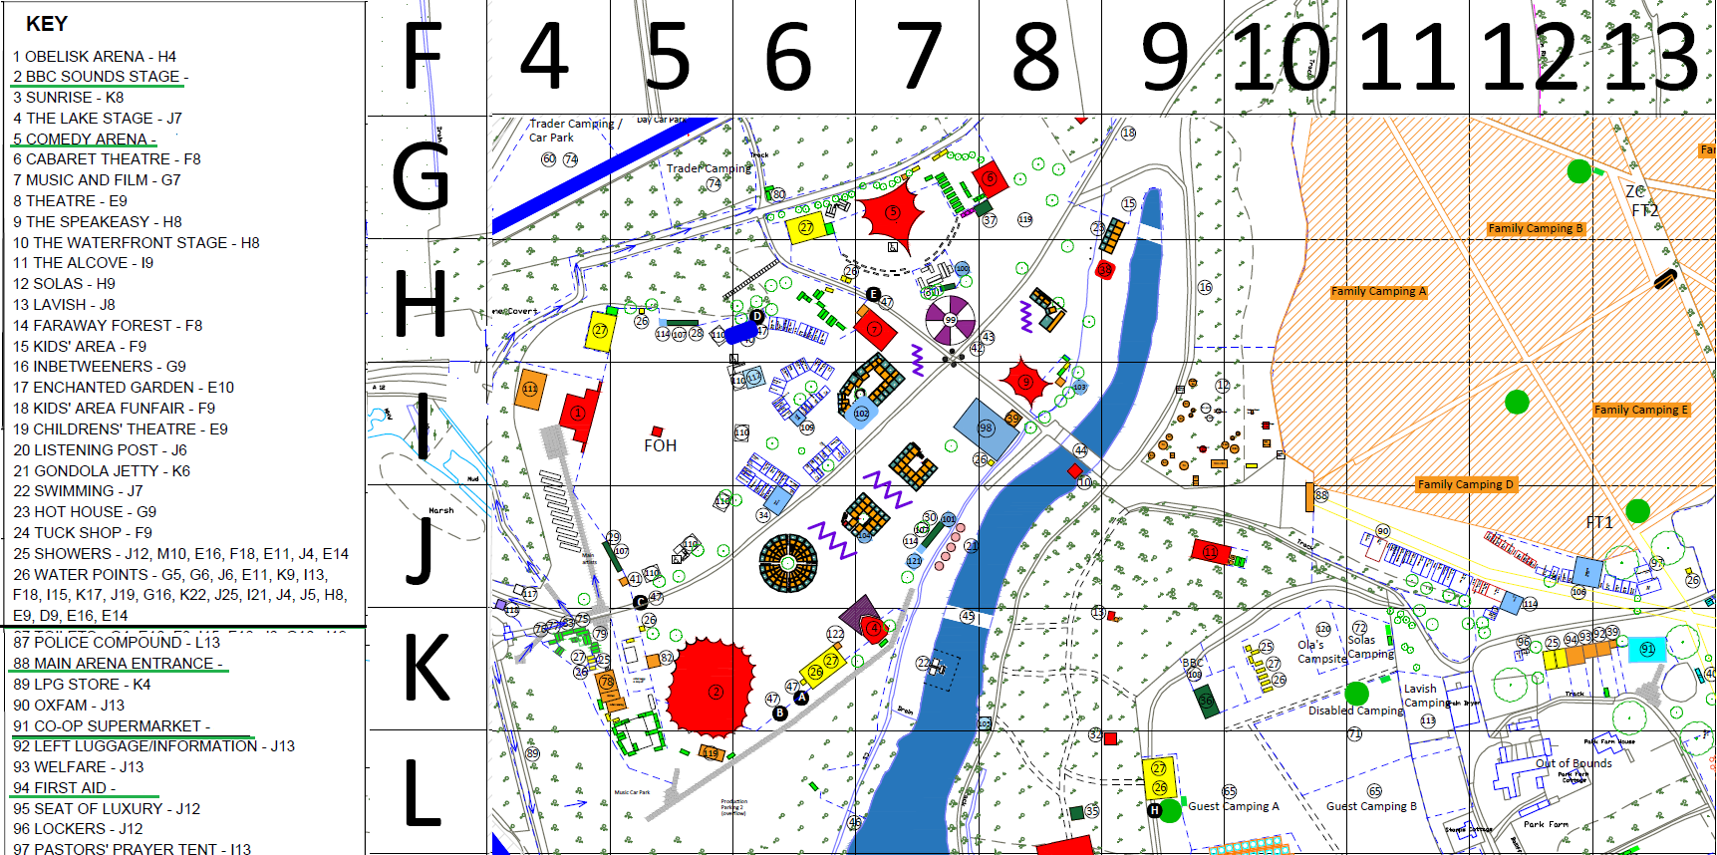
NAVIGATING FESTIVAL SITEMAPs
Notes:
Topic: Site Awareness – Grid References
Associated handouts/resources: A3 Laminated Maps
Facilitator Notes:
Explain that maps are produced for every festival and all staff use the same maps
There is a grid overlay on the map, that divides the site into squares
When reporting grid locations, the normal convention is letter first followed by the number
<Radio phonetic alphabet on the next slide>

Slide 25
RADIO PHONETIC ALPHABET
Alpha | Bravo | Charlie | Delta | Echo
Foxtrot | Golf | Hotel | India | Juliet
Kilo | Lima | Mike | November | Oscar
Papa | Quebec | Romeo | Sierra | Tango
Uniform | Victor | Whiskey | X-ray | Yankee
Zulu
Notes:
Topic: Radio Communications
Associated handouts/resources: none
Facilitator Notes
Before showing slide explain we use the NATO Phonetic Alphabet for spelling letters over the radio - for grid references etc.
This is the standard across professional services: armed forces, the police, medics, Festival Event Control etc. We want our stewards to come across in a professional manner that is easily recognised. Some of the words may seem a little old fashioned but were chosen to be distinct and not confused over radio waves.
Take a quick look and see if you can remember just a few. You will be asked again later. But don’t worry, it’ll be in your handbook on site.
Stop sharing slides now

Slide 26
KEEPING SAFE

Slide 27
Staying safe
DO NOT SHARE SCREEN TRAINER NOTES ONLY
Notes:
Topic: Staying Safe
Associated handouts/resources: None
Facilitator Notes:
Be aware that festival environments are not immune to crime or deviant behaviour. Some of the hazards and issues you may encounter include
Noise (whilst you’re working)
General site hazards
Crowd Safety
Theft
Sexual assault
Drugs
Aggression
Fires
Hazardous Substances
Weather
We’re going to explore some of these issues in a little more detail

Slide 28
NOISE AT WORK
Notes:
Topic: Noise at Work
Associated handouts/resources: Earplugs if available
Facilitator Notes:
Hearing damage:
can happen very quickly
is permanent and irreversible
causes stress, pain and irritation
may affect your ability to work
Keep your time in high-noise areas as short as practical
don’t stand close to speakers
take breaks in a quiet area
use supplied hearing protection– it is mandatory
Please ensure the following is said
Local councils and the HSE often carry out observations and pick up non-compliance, as will as some senior Festival managers.
It is MANDATORY for stewards to wear ear plugs in high noise areas and they will be provided by your supervisor or you will pick them up from the Oxbox. If you do not wear ear protection you will be stood down from your position.
Share Slide
Use the slide to highlight how to use foam earplugs.
Highlight - Check the fit by placing your hands over your ears. If sounds are much more muffled with your hands in place, the earplug may not have sealed properly. Take the earplug out and try again.
Please end by saying; Remember, it is for your own protection above all.
Image taken from https://earplugstore.typepad.com/got_ears_get_informed/2014/03/do-you-know-how-to-properly-insert-your-foam-ear-plugs.html

Slide 29
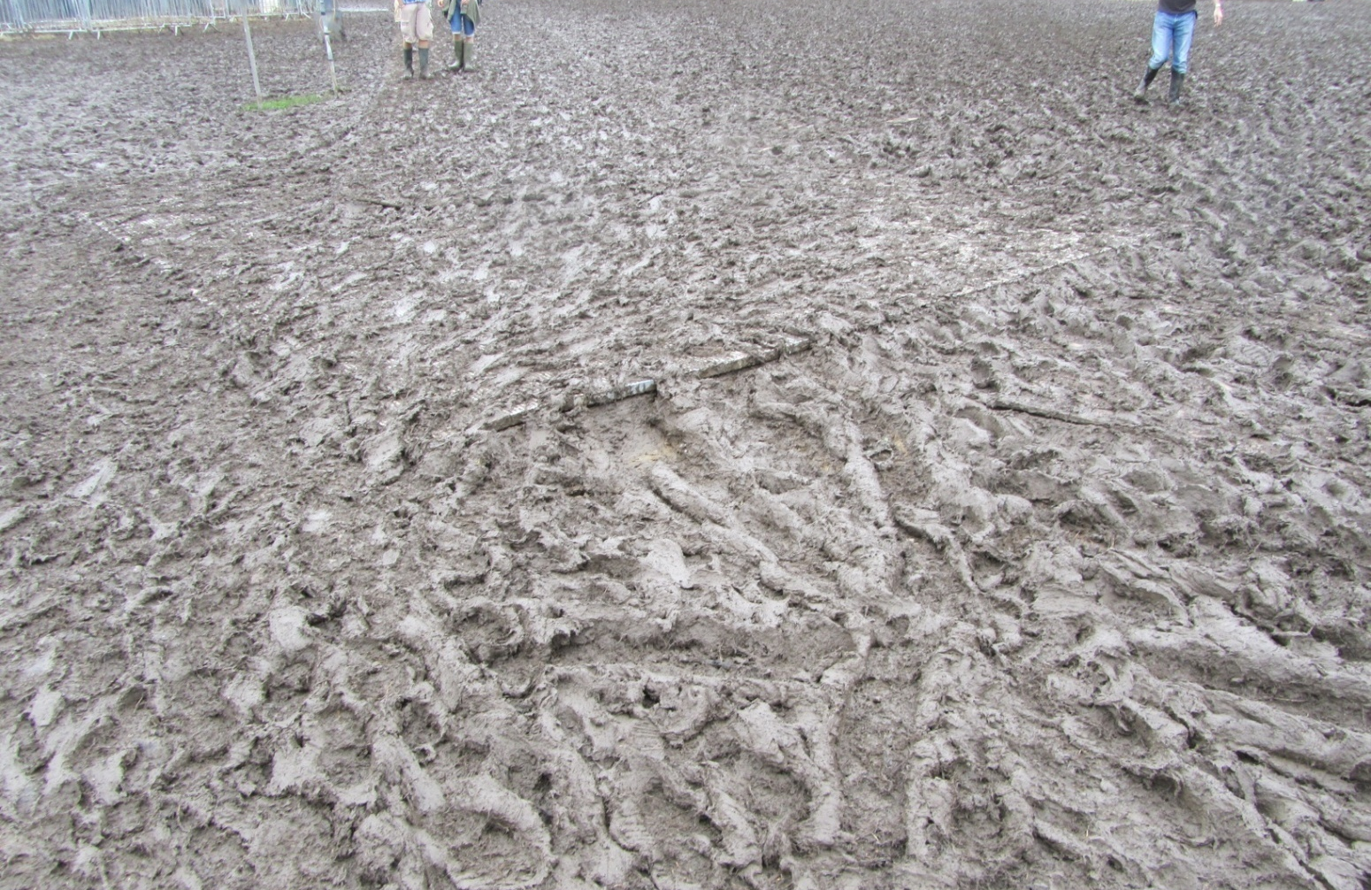
Notes:
Topic: Hazard Awareness
Associated handouts/resources: none
Facilitator Notes:
NB You need to cover some examples of potential hazards but if time is short you don’t need to cover all of them.
Point out here that all stewards are responsible for hazard awareness and should report in anything even if they are off duty.
These photos illustrate some of the hazards on site that you may come across.
Metal fence panel buried in mud – trip hazard, could damage ankle

Slide 30
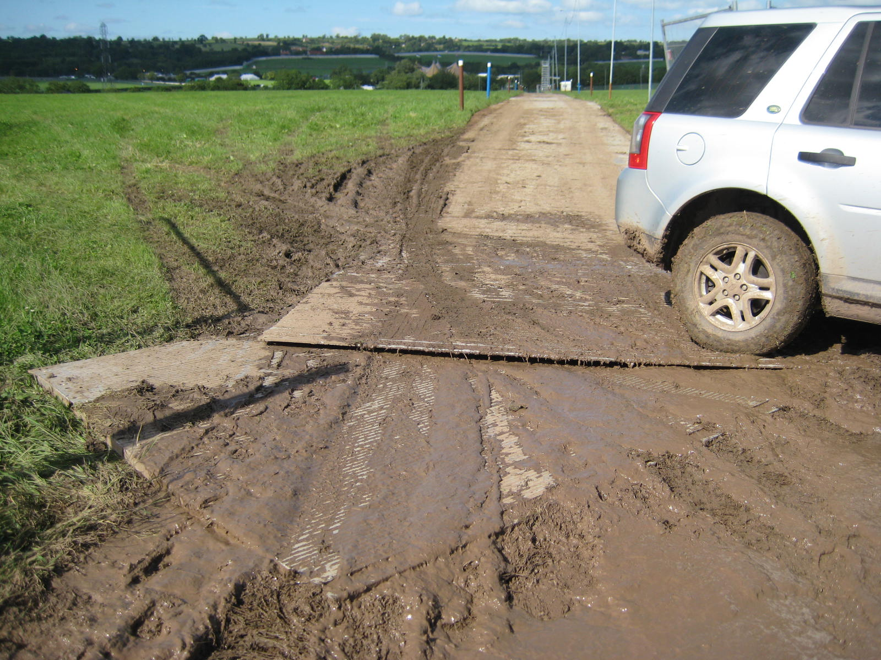
Notes:
Topic: Hazard Awareness
Associated handouts/resources: none
Facilitator Notes:
Broken or badly raised trackway – trip and slip hazard, also a large vehicle could potentially propel the loose sheet into people

Slide 31
Notes:
Topic: Hazard Awareness
Associated handouts/resources: none
Facilitator Notes:
Unprotected ditch or bridge edges – easy top fall off the side particularly when dark

Slide 32
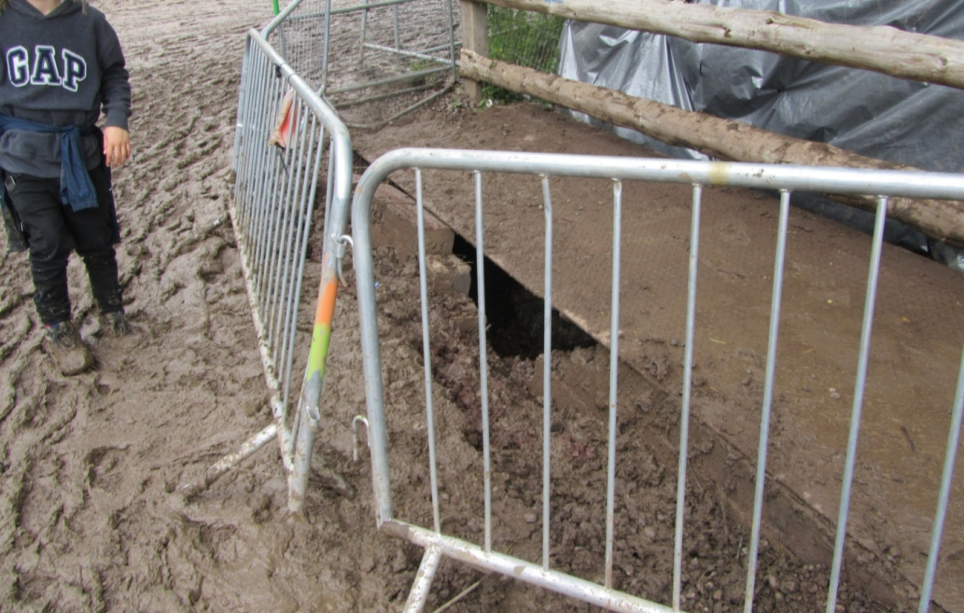
Notes:
Topic: Hazard Awareness
Associated handouts/resources: none
Facilitator Notes:
Major potholes (anything bigger than a foot across and 4 inches deep)
Damaged/ineffective fencing – close it. A child could squeeze through

Slide 33
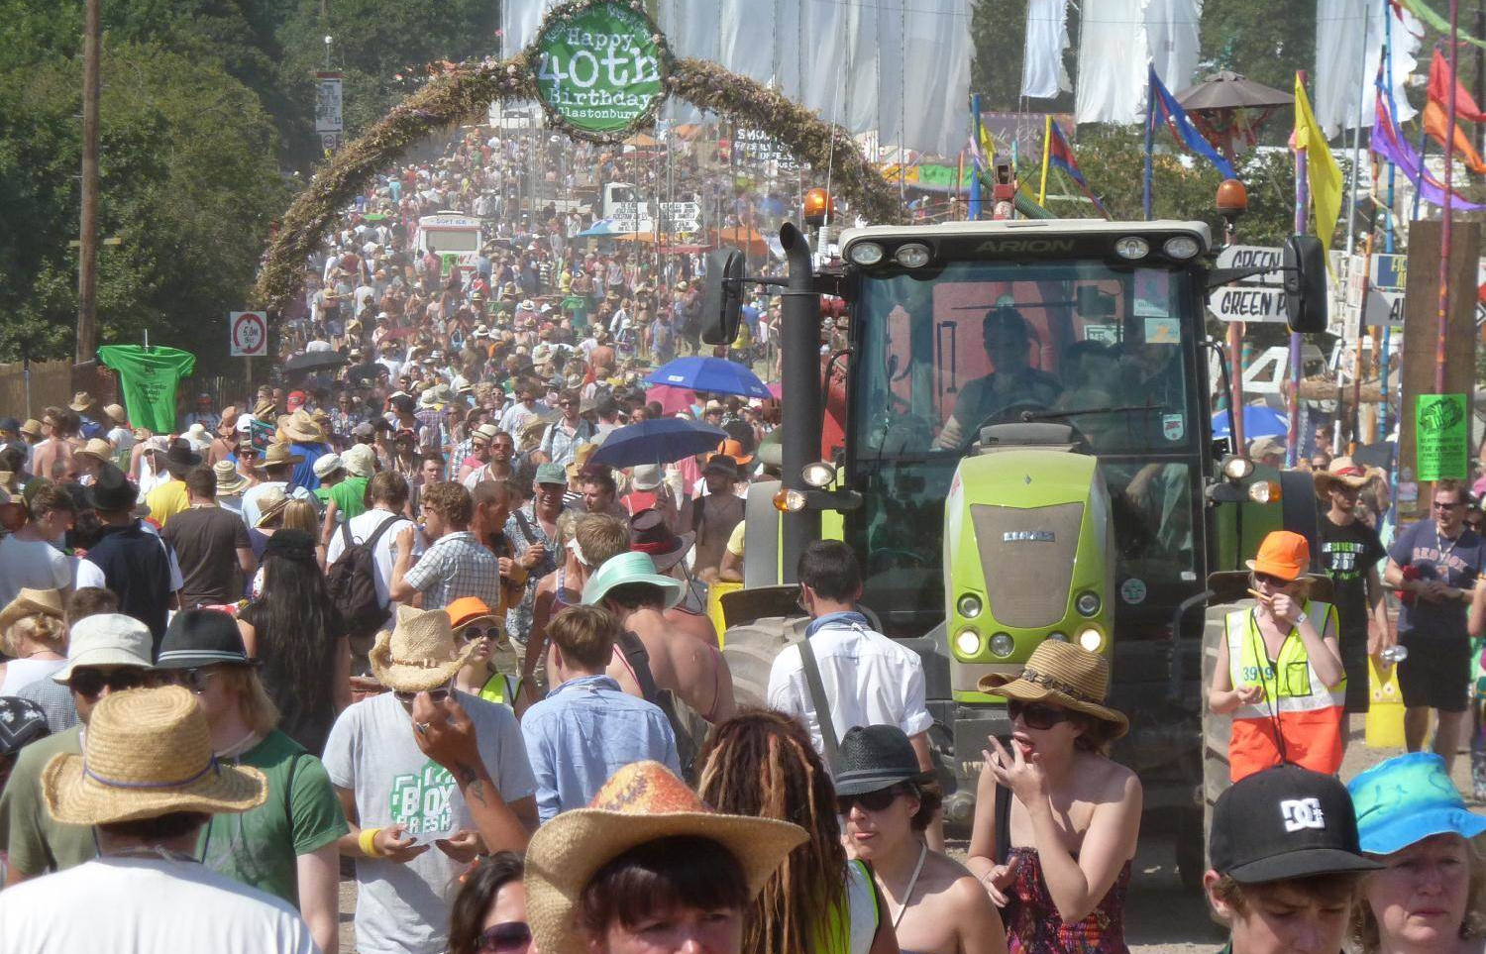
Notes:
Topic: Hazard Awareness
Associated handouts/resources: none
Facilitator Notes:
Large vehicle in pedestrian traffic
Further:
Unless otherwise instructed we don’t tend to chaperone vehicles
On occasion we agree to, if so then follow instructions
Ensure that you don’t walk in front of a vehicle unlike as shown here
GFEL steward is also eating while working – may be distracted as a result

Slide 34
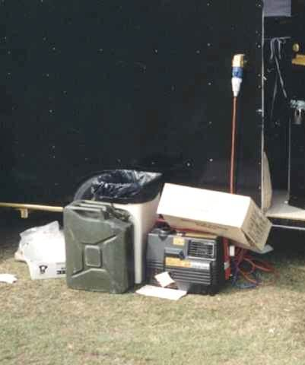
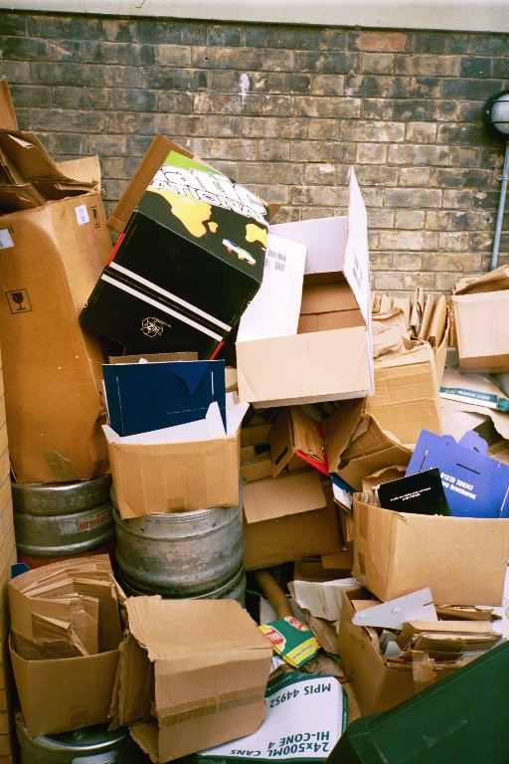
Notes:
Topic: Hazard Awareness
Associated handouts/resources: none
Facilitator Notes:
Build up of flammable waste
Flammable liquids should be stored safely

Slide 35
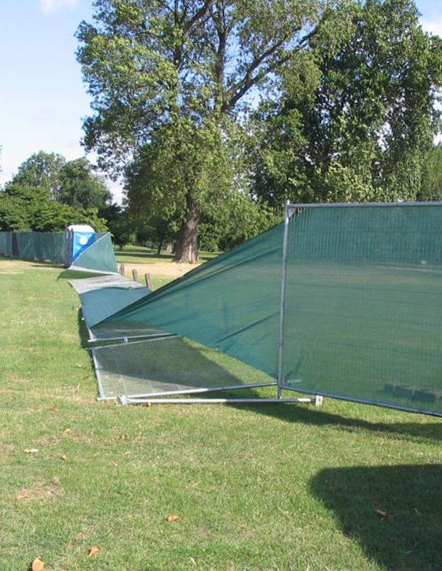
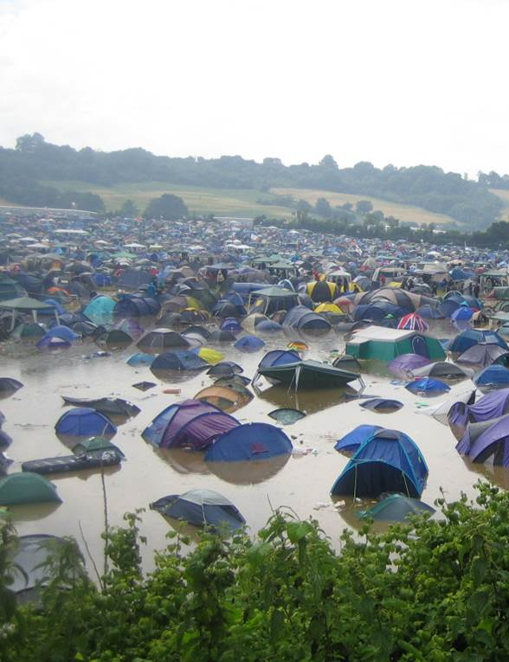
Notes:
Topic: Hazard Awareness
Associated handouts/resources: none
Facilitator Notes:
Weather can be a risk factor on site
Blown down fencing could crush vehicles, tents or people

Slide 36
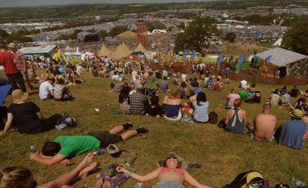
Notes:
Topic: Hazard Awareness
Associated handouts/resources: none
Facilitator Notes:
Bit tongue in cheek this one! – but seriously…
We do get sunshine at festivals! and everyone enjoys it when we do.
Be careful though – sunburn and heatstroke are not much fun
Wear hats, use sunscreen, drink water

Slide 37
Notes:
Topic: Hazard Awareness
Associated handouts/resources: none
Facilitator Notes:
Traffic one of the biggest hazards to festival goers, especially in crowds.
Not all as whacky as this one – but can be as dangerous as the big trucks.
Vehicles should be escorted through crowds, keeping to speed limit, not using hazard lights – not always by us
Chap sitting on a plastic barrel none too safe either!

Slide 38
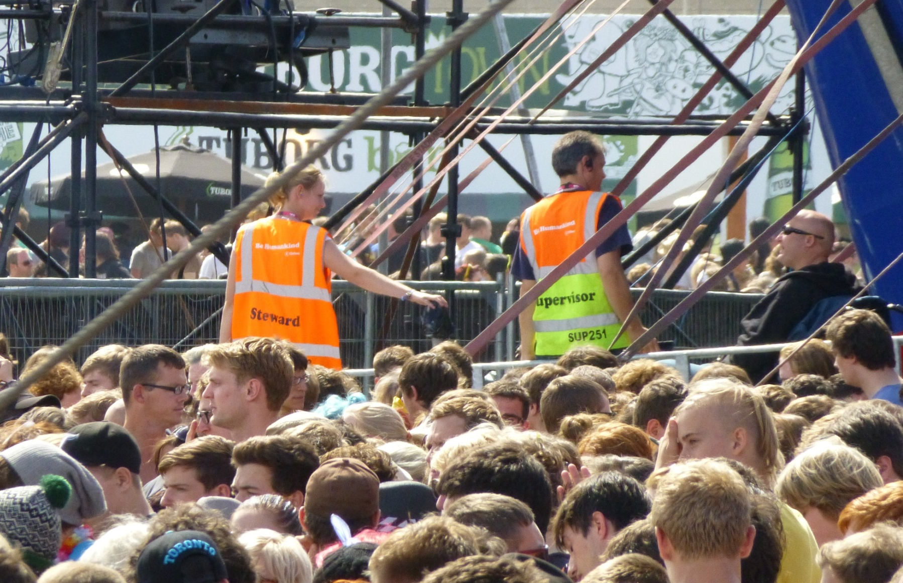
Notes:
Topic: Hazard Awareness
Associated handouts/resources: none
Facilitator Notes:
The hazard is the crowd
At a venue or stage, if you can only see heads, not heads and shoulders there may be a problem.
In a moving crowd: start to be concerned if there are more than 4 people or more per square metre
Security will deal with poor crowd behaviour at a venue i.e: stage invasion, and crowd surfing and will have “spotters” on the stage to spot problems and take necessary action.
Stress the importance of making sure crowds stay out once they have been evacuated and again the importance of keeping emergency exits and fire lanes free.
As a general rule, learn to think in terms of a percentage of the overall capacity. This is your best guess based on common sense. So talk about “75% Full” rather than “Quite full” It is much easier for others to understand and visualize, and is the way Event Control describe venue areas, fields etc.
Always be crowd-aware
At a venue or stage, you should be able to see heads and shoulders when you look across a crowd
If you see any issues where you believe there are too many people in a given area, please report it
Keep emergency exits and fire lanes free
Are there large unexpected movements of people progressing towards your area? This could be an issue, monitor these situations.
If in doubt, get a second opinion!

Slide 39
THEFT
DO NOT SHARE SCREEN TRAINER NOTES ONLY
Notes:
Topic: Theft
Associated handouts/resources:
Facilitator Notes:
Leave unnecessary valuables at home. If you need to bring expensive items, check if there are secure lockers available to store them.
Beware of pick pockets and don’t keep valuables in outside pockets whilst in crowds. It’s better to keep them in a bumbag or money belt rather than a rucksack
Never leave valuable items in your tent when you are not there. When you are sleeping, keep valuables in the bottom of your sleeping bag.
Try to avoid taking large sums of cash with you.
You can register your valuables with Immobilise, the UK national property register. This may improve the chances of getting them back if they are lost or stolen.

Slide 40
SEXUAL ASSAULT
DO NOT SHARE SCREEN TRAINER NOTES ONLY
Notes:
Topic: Sexual Assault
Associated handouts/resources:
Facilitator Notes:
All festivals have a zero-tolerance policy towards any kind of sexual harassment or violence.
Festivals are places to meet new people and make friends. Help to keep yourself safe by staying alert and being aware of what's happening around you. Is that person safe, do they need help?
Familiarise yourself with first aid and welfare locations.
Sexual assault is never ok. If you witness any kind of sexual assault don’t just ignore it. Report what you have seen to a member of the security team immediately or if on duty your supervisor / Oxbox.
If you have a safeguarding concern – you can speak to Oxbox / Coordinators or can report anonymously online at - https://oxfam.clue-webforms.co.uk/webform/misconduct/en
This could include physical, sexual, psychological, financial and material, discriminatory neglect/ self neglect and domestic abuse. All adults regardless of age, gender, disability or ethnic origin have a right to be protected from all forms of harm, abuse, neglect and exploitation. All Concerns and allegations will be taken seriously and support will be offered.
Don’t be afraid to speak up and report an incident – whether that’s with an Oxfam Coordinator, the Oxbox, your supervisor, security, festival welfare or medics. There will be posters in the marquee explaining how and where you can report, if you need to.
Lots of festivals work with Safe Gigs for Women – introduced in 2015 with the aim of reducing the instances of sexual assault in live music
Oxfam encourages all of our volunteers to be “active bystanders” to challenge any form of harassment
Direct – call out the behaviour if you feel safe to do so “that’s not appropriate”
Distraction – Find an excuse to take the person on the receiving end out of the situation – “hi – didn’t we go to school together?”
Delegate – Talk to your supervisor, or if you’re not at work, ask someone else in your group to intervene, or alert security, other stewards, bar staff, welfare etc
Delay – offer help or support after an incident, or when you are not sure if what you have seen is something that needed intervention

Slide 41
DRUGS
DO NOT SHARE SCREEN TRAINER NOTES ONLY
Notes:
Topic: Drugs
Associated handouts/resources:
Facilitator Notes:
All drugs are potentially dangerous; there are no harmless drugs. The only way to avoid risks is not to take drugs at all. This goes for new psychoactive substances (formerly known as 'legal highs’) as well.
Some festivals offer drug testing with charities such as The Loop to reduce harm and raise awareness to the public.
If you think someone is intoxicated and could be a danger to themselves or others, then report it to your supervisor / Oxbox and advise them or their friends to go to welfare.
The Festivals and Events Team consider volunteer and staff wellbeing to be of the upmost importance - and all instances of drugs or alcohol misuse are dealt with by putting the welfare of the individual concerned first before considering any further action.
Some info from The Loop:
Remember that illegal drugs can vary in strength and purity. Unless drugs have been tested, you can never know exactly what is in them or how strong they are. Even on-site testing is of limited use.
Before taking drugs, consider your environment and how you might feel when intoxicated there
Be open with your friends if you are taking drugs and look after each other. If anyone feels unwell encourage them to seek medical attention or visit the welfare team.
Remember that tolerance levels can vary. You may not have the same tolerance level as your friends so always start low and go slow
Beware of mixing different substances and/or alcohol. For example alcohol and ketamine can be a potentially lethal combination.
In recent years, there have been a number of deaths related to very high strength ecstasy pills. As with all drugs, if taking ecstasy you should start low and go slow.

Slide 42
AGGRESSION OR VIOLENCE
DO NOT SHARE SCREEN TRAINER NOTES ONLY
Notes:
Topic: Aggression
Associated handouts/resources:
Facilitator Notes:
Signs to watch for:
Intense eye contact
Abuse focused on you personally
Increasingly abusive/threatening language
Your personal space being invaded
Pointing - possibly leading to physical contact
Square on posture
Position – allow exit, don’t block or be blocked
Attitude – positive and helpful
Look and Listen
Make space – comfortable distance
Stance – side on, shoulders relaxed
Keep your ego in check!!!
Be professional and courteous (friendly, fair but firm)
Build a rapport
If the person is clearly angry, try and move them to one side, and just listen quietly and be calm, until they calm down. Only then will any communication and reconciliation take place.
Try to see their point of view
Look for a win-win outcome
Accept you cannot win them all! Let it go…
And always - Keep safe
Extra notes:
Self explanatory – be friendly but professional. Smiling is good in many circumstances, be relaxed - but aware of appropriateness.
Rapport - sometimes it helps to explain we are trying to keep everyone safe, we don’t want anyone getting hurt. Sometimes that means we have to restrict access to a gate or venue, which we understand can be a problem for others. We should be able to suggest alternative routes or venues.
Not winning them all – sometimes people want something they can’t have and there’s nothing you can do about it. They may not be very nice! Be calm, don’t take it to heart.
Conflict situations are not necessarily threatening, they are often a difference of views. Get security help at all times though if the situation is threatening.
Don’t forget, when you’re out and about:
If you see trouble, report it. Prevention is better than putting yourself in danger.
Consider how your own behaviour could be interpreted and be sensitive to the fact that when people are intoxicated things can be taken the wrong way.
Festival sites are huge! You don’t need to stick around in one place if you feel uncomfortable.
Verbal abuse is still abuse and should not be tolerated from members of the public, other volunteers or festival staff. Report it.

Slide 43
FIRES
DO NOT SHARE SCREEN TRAINER NOTES ONLY
Notes:
Topic: Fires
Associated handouts/resources: video
Facilitator Notes
Fires
Sometimes you will see, or be alerted to, a fire, that may be a hazard
Is it a hazard?
Somewhere where fires are not allowed?
Causing an immediate danger to people or tents?
Close to a vehicle or sources of fuel?
Is the ground dry, and the fire in danger of spreading?
Are people putting things on the fire that might cause it to become dangerous?
If yes –
Act promptly and calmly
Find somebody with a radio
Radio or call the Oxbox
Be aware of any code words in use
Many areas in a festival will have fire extinguishers relevant to the type of fire risk. You won’t be expected to know the different types and applications
Only tackle a fire if it is safe to do so and it’s a small fire
SMALL AND CONTAINED: Size of a wastepaper basket or smaller. Or size of fire extinguisher.
The rules are:
Only tackle a fire if you are confident
Always use an extinguisher
Approach no closer than 3 m
Test the extinguisher before you start out
Direct the extinguisher low to the very base of the fire
Empty the whole extinguisher on it.
Keep people away
Remember you are the expert and ignore helpful hints from bystanders
Never turn your back on a fire
If in doubt call the fire brigade
Fires at festivals are often caused by:
Pyrotechnic displays
Tent fires: accidental or deliberate
Bonfires getting out of control
Unattended campsite fires
Cigarettes and lighters
Litter build-up in venues
Camping Gas stoves
Disposable barbecues
If a person is on fire, the advice is to :
STOP
DROP
ROLL

Slide 44
Hazardous substances
If you think somebody has been exposed to a hazardous substance then use caution and avoid exposure yourself.
Tell the victim to:
Notes:
Topic: Hazardous Substances
Associated handouts/resources:
Facilitator Notes
In case of acid attack, or exposure to other hazardous substances remember: REMOVE REMOVE REMOVE
Tell those affected to :
Remove themselves from the immediate area to avoid further exposure
Remove outer clothing if affected by the substance,. Try to avoid pulling affected clothing over the head/face
Remove the substance from skin using a dry absorbent material to either soak it up or brush it off.
Rinse continually with water if the skin is itchy or painful

Slide 45
Time for a quick break
Notes:
If the timings work, hopefully you should have 10 minutes for a break!

Slide 46
CASUALTIES & REPORTING MEDICALS

Slide 47
Casualties
DO NOT SHARE SCREEN TRAINER NOTES ONLY
Notes:
We do not expect stewards to perform first aid, this information is to inform on how to manage a casualty.
Stewards should simply care for any unconscious casualty regardless of cause, by calling in to their supervisor to get medical help, and look after them in the meantime. Don’t assume the unconscious person is under the influence of alcohol or drug.
Check it’s safe to approach
Ask a direct question to the casualty
Nudge their feet or gently shake their shoulders
CONSCIOUS CASUALTIES
If the casualty responds to you then they are not unconscious - however they may be unable to look after themselves which is why we call for help.
Don’t move them unless they are in danger; build up a picture of what happened and then radio for help
Remember the need to be extremely specific about your exact location when calling for medical help.
Consider your own safety. You will be in twos, once you have called for help one should stay with the casualty, the other take up a position nearby, remaining in visual contact but keeping watch for medics arriving. Wave them in and take them to the scene.
Monitor casualty’s condition until help arrives – if anything changes update Oxbox. Get as much information and help from their friends as possible (although sometimes they may not want to tell you details if illegal substances are involved)
If the casualty recovers (this can happen as the effects of substances wear off) they may not want to wait for the medical team to check them over. Advise them to contact the medical centre if they feel unwell. The welfare teams can also offer space for people to recover from the affects of substances.
If someone appears OK and does not need immediate medical assistance, and is accompanied by a sober person (friend), suggest taking the casualty somewhere quiet, to stay with them (monitor) and to have water / a cup of tea etc. Inform them to contact medical (or come back) if they need further assistance.
Be considerate of the patient – sometimes festival goers can stand around and watch whilst you are treating a casualty – encourage them to move away so that the patient has some privacy (request additional stewards from your team leader if possible)
Make notes for completing incident report form
UNCONSCIOUS CASUALTIES
Check it’s safe to approach
Ask a direct question to the casualty
Nudge their feet or gently shake their shoulders
If there is no response, check they are breathing
The information about checking breathing and putting the casualty on their side is taken from the current Red Cross website
To check if a casualty is breathing you can:
Check their breathing by tilting their head back and looking and feeling for breaths.
When a person is unresponsive, their muscles relax and their tongue can block their airway so they can no longer breathe. Tilting their head back opens the airway by pulling the tongue forward.
If they are breathing, you will see their chest moving and you may hear their breath or feel it on your cheek. You can also use the back of your hand (or your steward buddy can use the back of their hand) to feel for them breathing out.
If your casualty is not breathing – you need urgent medical assistance. Using a radio, break in to any ongoing conversations with the words “priority priority priority” and explain that you have a non-breathing casualty and give your location.
If they are breathing, move them onto their side and tilt their head back.
Putting them in this position with their head back helps keep their airway open. It ensures their tongue falls forward and blood and vomit drain out. It is sometimes called the “recovery position”.
Please say this at end:
Do not administer first aid yourself when on-shift with Oxfam except for the recovery position – if you are first aid trained and feel as a human being you have no option but to administer it yourself, please take off your tabard, and give this as a member of the public. Oxfam's liability insurance does not cover first aid.
Model answers in case of questions (taken from the British Red Cross website):
If I think they have a back or neck injury, should I still turn them on their side? Yes, if you suspect a back or neck injury, you should still move them on to their side so they can keep breathing. Try to keep their spine in a straight line when turning them. If possible, get someone to help you turn them.
Should I try talking to someone who is unresponsive and breathing? Yes, talk to them and reassure them. Even if they do not respond to you, they may still be able to hear what is going on.
What do I do if the unresponsive person’s breathing doesn’t seem normal? Sometimes when a person is unresponsive their breathing may become noisy, irregular or gasping. This is usually a sign that their heart and lungs are not working properly and you should treat them as an unresponsive person who is not breathing.
What should I do if someone is feeling faint? If someone is feeling faint, tell them to lie down on their back and raise their legs. This will improve the blood flow to their brain. Fainting is caused by a temporary reduction in the flow of blood to the brain and can result in them becoming unresponsive for a short time. A person who has fainted should quickly become responsive again. If they don't, treat them as an unresponsive person.

Slide 48
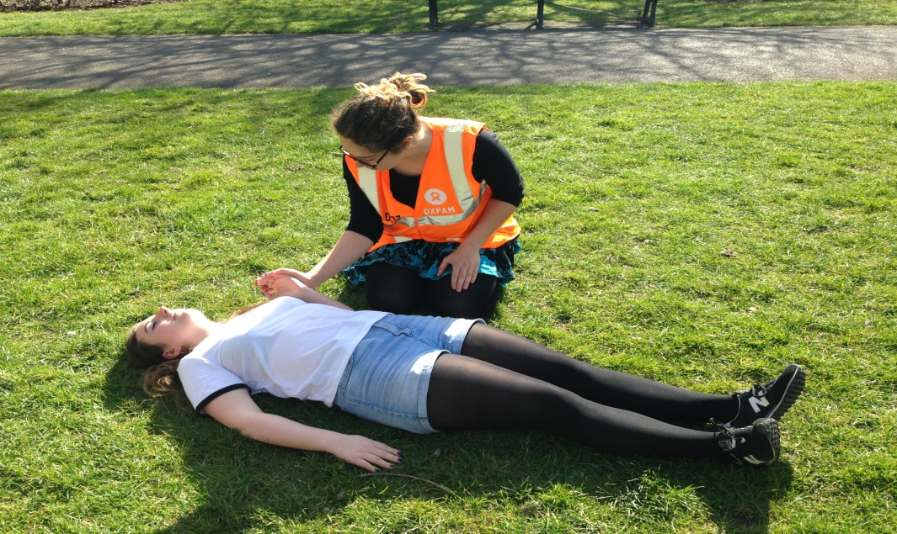
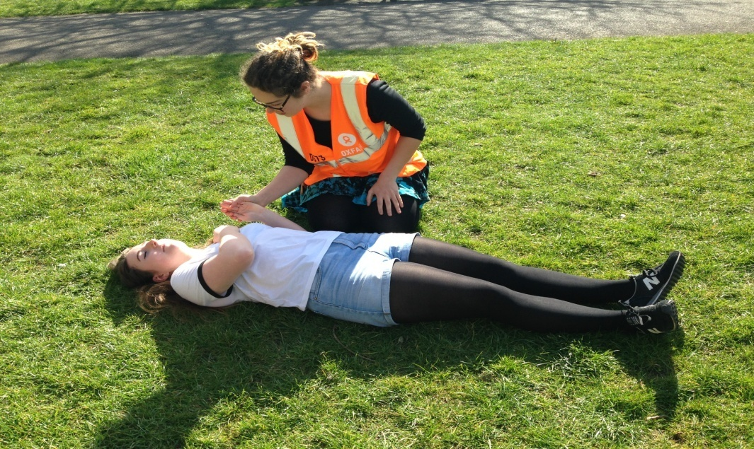
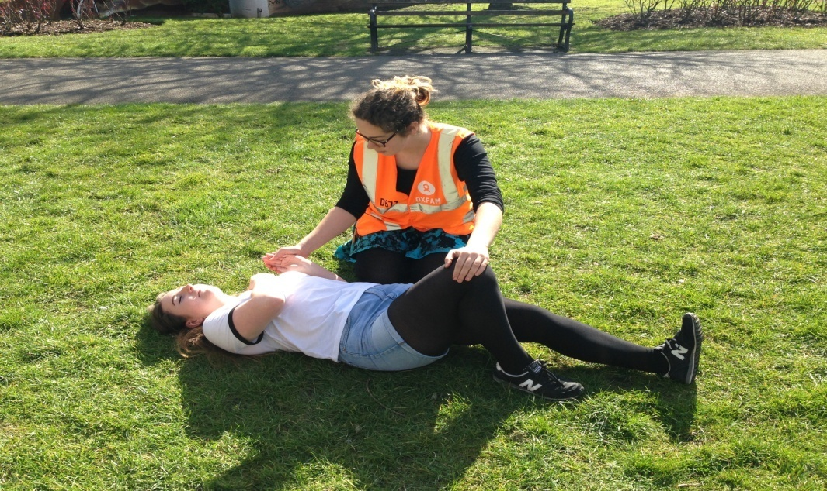
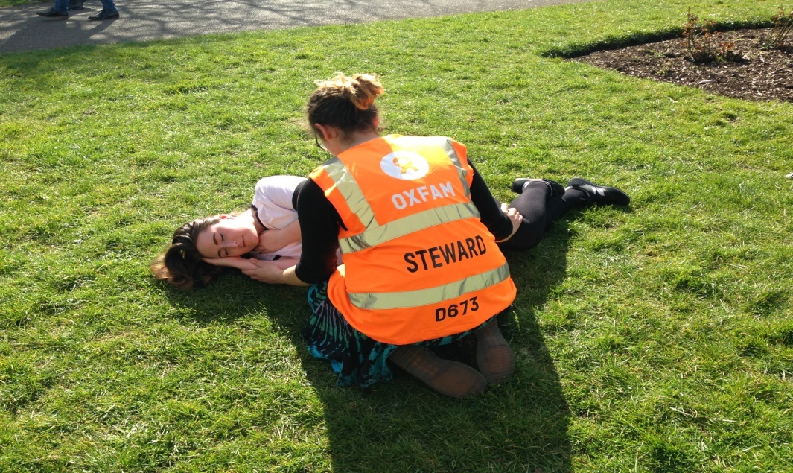
RECOVERY POSITION: HALO
HAND
ARM
LEG
OVER
Notes:
Topic: Casualties- Recovery Position
Associated handouts/resources: none
Facilitator Notes
If you find a casualty and are confident that there is no chance of head or neck injury, then you may want to put them in the recovery position to avoid aspirating vomit
If there is a possibility of head or neck injury then absolutely do not move the casualty THIS CONTRADICTS THE ADVICE OF THE RED CROSS ….
If you suspect a back or neck injury, you should still move them on to their side so they can keep breathing. Try to keep their spine in a straight line when turning them. If possible, get someone to help you turn them.

Slide 49
Reporting a medical
Get as much information and help from any friends or bystanders as possible
Grid Reference
Age
Gender
Breathing
Conscious
Responsive
Report directly to Oxbox
Remember “PRIORITY PRIORITY” in case of immediate danger to life
Notes:
Topic: Reporting a Medical
Associated handouts/resources: none
Facilitator Notes
Very important to collect all the above information as at most festivals medics won’t attend until it has been provided
Quicker to get the info first and then call it in rather than call in a panic and then having to collect each piece of info when prompted by control
Worst case: Major medical, call 999. But only in absolute emergency, calling 999 for a festival will only involve the control room talking to the festival anyway, so it is always best where possible to report via a radio or someone with a radio.
Stay with casualty and monitor condition until help arrives
Report new information if anything changes
If possible have a second steward available to guide the medics
Make notes for completing incident report form after

Slide 50
Trainers attention test
1
2
3
4
5
6
7
8
9
10
11
12
Notes:
FACILITATORS:
This is to make sure that participants complete all of the training. There are 3 points in the presentation when they need make a note of the picture that’s shown, and then input it as an answer in the evaluation form. This is the first (make a note of which slide you’re used).
This is a navigation slide, designed to help you easily jump around this section of the presentation. In presentation mode, click any numbered square and the presentation will move to that slide. Once you’ve shown the image slide, click the number “1” in the bottom right hand corner to return to this slide.
Explain to participants:
This is an attention test, to make sure you are all still participating in the course
You need to carefully note the image you are seeing as you will need to enter it into the evaluation form using a drop down menu
If your answers are wrong in the evaluation form, you may receive a follow up call from the Steward Coordination Team to discuss

Slide 51
EMERGENCIES

Slide 52
evacuation
DO NOT SHARE SCREEN TRAINER NOTES ONLY
Notes:
Topic: Evacuation
Associated handouts/resources: Venue emergency exits
Facilitator Notes
As a steward, you should:
know the nearest and alternative escape routes for your venue
assist the vulnerable if safe to do so
guide people through and beyond exits towards assembly point or safe open space
stop anybody re-entering once they are evacuated
Stewards should try to help the disabled and vulnerable.
You might have to evacuate a venue for reasons other than fire e.g. when the seating or stage collapse
Always work in a confident, controlled manner and keep people moving.
Never put yourself in danger

Slide 53
Notes:
Topic: Terrorism Awareness – Run Hide Tell
Associated handouts/resources: None
Facilitator Notes
https://www.youtube.com/watch?v=aLIvV5T-ajU

Slide 54
Terrorism awareness
DO NOT SHARE SCREEN TRAINER NOTES ONLY
Notes:
Hostile reconnaissance
Stewards are “alert not alarmed” – what to look out for:
Concealing face or identity
Taking photos of staff, gates, CCTV
Asking unusual or security related questions
Avoiding security staff
Activity inconsistent with the nature of the building or area
Use your judgement and don’t stereotype
Remember that in a festival environment people will often be acting or dressing differently anyway
Often a simple "hello, how can I help you" can be a deterrent to someone intending to do harm
Suspicious Packages
Hidden: has the item been hidden? Has any attempt been made to conceal the item from view or place it where accidental discovery is unlikely? Innocent items are not usually hidden deliberately.
Obvious: is the item obviously suspicious? Can wiring or batteries be seen? Is it taped or contains liquids or powders? Has it been found after seeing suspicious behaviour?
Typical: is the item typical of what you might reasonably expect to find in the location? Also consider the current threat? Ask has anyone left the item?
If the answer is yes to any of the above, report it
HIGHLIGHT: Be reassured yourself, and reassure the public if asked; we have an Action Plan in place, intelligence and incident led, with escalation procedures and resident experts from appropriate agencies

Slide 55
USING RADIOS

Slide 56
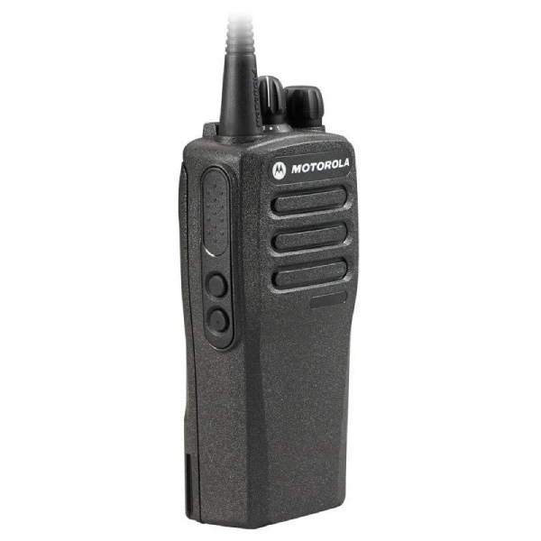
Aerial
Channel selector
Volume
Speaker
Push-to-talk button
Microphone
Notes:
Topic: Radio Communications- Controls
Associated handouts/resources: none
Facilitator Notes
Just talk through functions
Do not say red light is for low battery. The lights and colours depend entirely on the type of radio units being used which changes from show to show

Slide 57
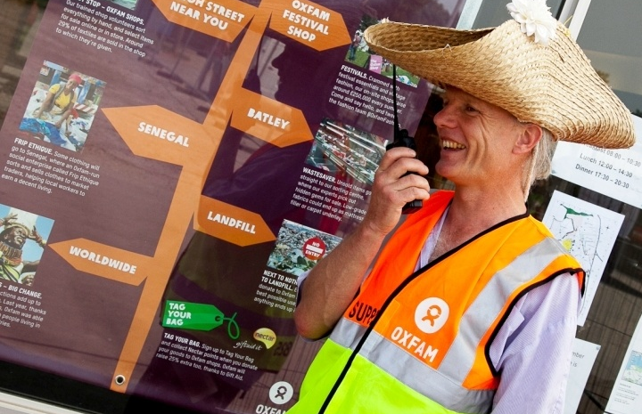
If you are given a radio
If You’re Given a Radio
Keep hold of it
Check it works
Leave it turned on
Keep it dry
Know any code words
Notes:
Topic: Radio Communications
Associated handouts/resources: none
Facilitator Notes
Only use a radio if you have received instruction on using it. If you’re not confident ask / say at this point.
Look after your radio carefully. Keep it on your person.
Easiest way to check it works is simply to turn it off and back on and wait for the beeps
Only if you’re unsure and the channel is quiet, do a radio check to check that the radio is working.
If the signal starts to breaks up in an area that has worked fine, or you hear low frequency beeping the battery is going flat
Leave the radio switched on at all times with the volume turned up as loud as it needs to be. But remember – the louder it is, the quicker the battery will run down
Keep the radio where you can hear it not in a bag or pocket
Do not put it anywhere where the push-to-talk switch can be operated unintentionally as this stops everybody using their radios
Ask for a belt clip, radio holder or earpiece if necessary
You should know the lines of communication to follow, i.e who you call for assistance / information.
details of any code words to be used i.e bomb = mr case, fire = mr ash /mr england.
the phonetic alphabet to spell out ambiguous words. (see back cover of stewards booklet)
If you lose a radio you may be charged £100 which will come out of your depoist.

Slide 58
Radio etiquette
DO NOT SHARE SCREEN TRAINER NOTES ONLY
Notes:
Topic: Radio Communications
Associated handouts/resources: none
Facilitator Notes
Summary:
Stay on our channel
Use call signs
Legitimate messages only
Listen at all times
Don’t crash conversations
Hold the PTT button for 3 seconds before speaking
Release the button when finished
Be concise
Spell difficult words and use phonetics
Over or Out, never both
In case of emergency: PRIORITY PRIORITY
Detail:
Make sure the radio is on the channel allocated to you.
Don’t fiddle with the channel switch unless you are told to go to another channel
Identify who you want to speak to and your location e.g. Circus Big Top this is Cabaret Tent, over
Oxfam convention: Who you want to reach (x2) then your location, over (which means you are expecting a reply).
Don’t speak if another message is taking place. Only break in if it is an emergency and use the words “priority, priority”
After pressing the mic/push-to-talk button count to 3 before speaking into the speaker on the front of the radio
Hold the radio about 6” from your mouth when speaking
Speak directly into the speaker
Release the talk button when you have finished speaking
Be clear and precise
Spell difficult words using phonetic alphabet
Importance of OUT. Letting other people know a convo is over
Priority, Priority for priority messages
Only use radios for legitimate messages - it needs to be stated that the radios are not there to ask where venues or stalls are - and control need to stop answering these questions for the message to get back to stewards that they should not be using the radios for this. The key information to get across is that if you don't know where a venue, stall or stage etc is then direct the paying public to the nearest information point where they will be helped.

Slide 59
Radio etiquette
Oxbox Oxbox, this is Dance Stage Supervisor. Over
This is Oxbox, go ahead, Over
Radio check. Dance Stage Out
Notes:
Topic: Radio Communications
Associated handouts/resources: none
Facilitator Notes
Example of a brief conversation following Oxfam guidelines
If you are new to using a radio, following the on site briefing one of the coordinators will do a short radio briefing

Slide 60
LOST & FOUND CHILDREN

Slide 61
Lost & FOUND CHILDren
DO NOT SHARE SCREEN TRAINER NOTES ONLY
Notes:
Topic: Lost and Found Children
Associated handouts/resources: none
Facilitator Notes
A child is defined as Lost if you have ‘reporting parents’ and no child
A child is defined as Found when you have a child who has lost their family
Be calm and supportive, listen and record details, establish time-line.
Radio or phone Oxbox for support
Be aware of festival policy – this might include not saying the child's name
Conduct a common sense local search if possible
Ensure you are not alone with a found child
In nearly all cases children are not far away and soon reunited.
The general rule for dealing with the parents of a lost child is to reassure and calm them. Have a look round the immediate area and report to the supervisor with as much information as possible to prevent excessive periods of distress and travelling around the site for all concerned.
Parents and friends will want to search the local area and the likelihood is that the child will not be far away. Tell parents to let a steward know if the child is found in the meantime. Ensure that Oxbox are kept informed of any developments.
The supervisor should let other stewards in the area know about the child and a watch can be ongoing till the child is found.
We do not fill out incident report forms for lost children, unless a specific festival requests it. Radio calls like this are logged by default, and inter-agency reporting is normally a sufficient audit trail

Slide 62
DISABILITY AWARENESS
Content provided by
Notes:
Topic: Disability Awareness by Attitude is Everything
Associated handouts/resources: none
Facilitator Notes
Live music is for everyone
Attitude is Everything improves Deaf and disabled people's access to live music by working in partnership with audiences, artists and the music industry
Oxfam has worked closely with this organisation for many years in order to make what we do as inclusive and accessible as possible.
To find out more, visit their website: www.attitudeiseverything.org.uk
Please don’t shy away from this section on disability awareness. It’s important training for people in the rest of their lives, not just whilst stewarding, and aie and festivals where we do disabled viewing platform roles are really pleased we’re including this.

Slide 63
People to consider on-site
Wheelchair users
People with mobility impairments
Visually impaired people
Hard of hearing people
Deaf people
People with learning disabilities
People with mental health conditions
People with invisible impairments
These people could be customers, volunteers, artists, traders, staff or colleagues on your shifts
Notes:
Topic: People to Consider
Associated handouts/resources: none
Facilitator Notes
If a person has a vision impairment, they may not make eye contact, or make it in another way such as by turning their head to one side. Just be aware of this.
People may not react as expected to danger warnings.

Slide 64
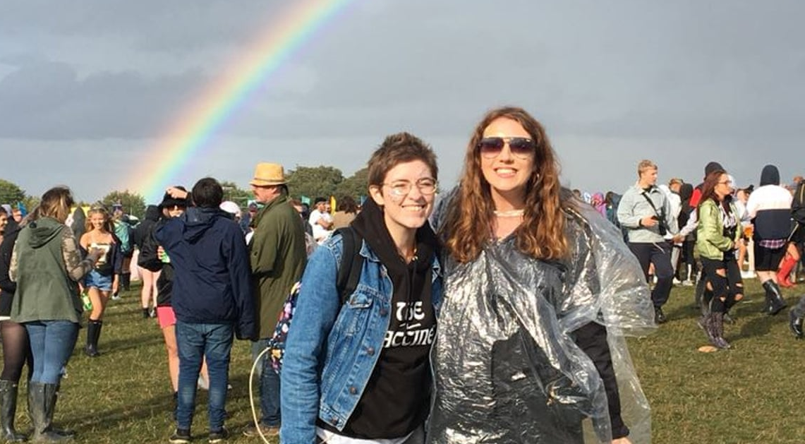
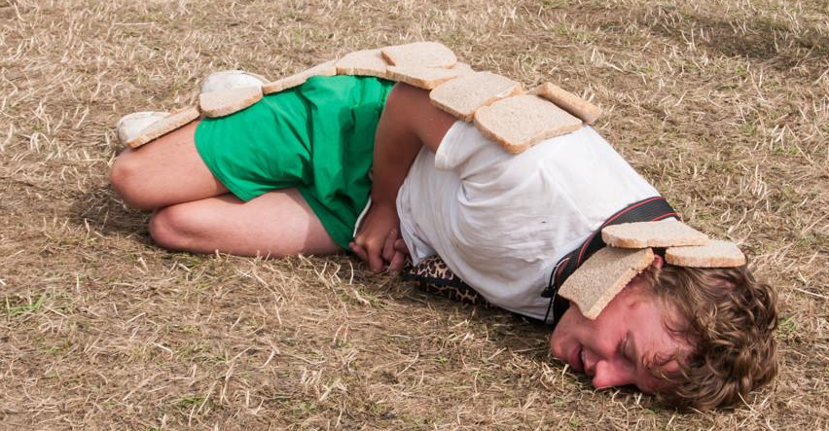
Offering assistance
Notes:
Topic: Disability Awareness by Attitude is Everything
Associated handouts/resources: none
Facilitator Notes
Who needs assistance here? We don’t know, could be all or none of them! Do not discriminate
Not all impairments are visible and less than 8% of disabled people are wheelchair users.
Use your judgement before offering assistance.
Don’t make assumptions – does a person have to look disabled to be disabled?
If you do offer help, wait until your offer of help is accepted before you start. Don’t be offended if people say “no”.
Listen to and be guided by the person. They know best how you can assist them.

Slide 65
Deaf & hard of hearing
If someone has an interpreter with them, focus on the person and allow time for the interpretation
Some people are able to lip read:
Use natural gestures and facial expressions - don’t exaggerate
Face the light and keep your hands etc. away from your mouth when speaking
You may need to speak up or shout so a person can hear you, but wait to be asked
Consider using pen and paper, or text on a mobile if needed
Notes:
Topic: Disability Awareness by Attitude is Everything
Associated handouts/resources: none
Facilitator Notes
There are people at any festival who are Deaf or hard of hearing.
If a Deaf person has an interpreter with them, maintain your focus on the Deaf person and allow time for the interpretation, rather than simply addressing the interpreter.
People may not hear danger warnings. If people don’t react in the way you expect, there might be a valid reason for this
Some people are able to lip read.
Use natural gestures and facial expressions (don’t exaggerate your lip patterns) to help people to read your lips. You should be aware that if you have facial hair or a strong accent, your lip patterns can be more difficult to read.
You may need to speak up or shout so a person can hear you, but wait to be instructed to do this by the person rather than launching in shouting at them!
When talking, face the light and keep your hands and other obstructions away from your mouth when speaking.
You also have the option of pen and paper, or using the screen of a mobile phone and texting in order to communicate with one another if needs be.

Slide 66
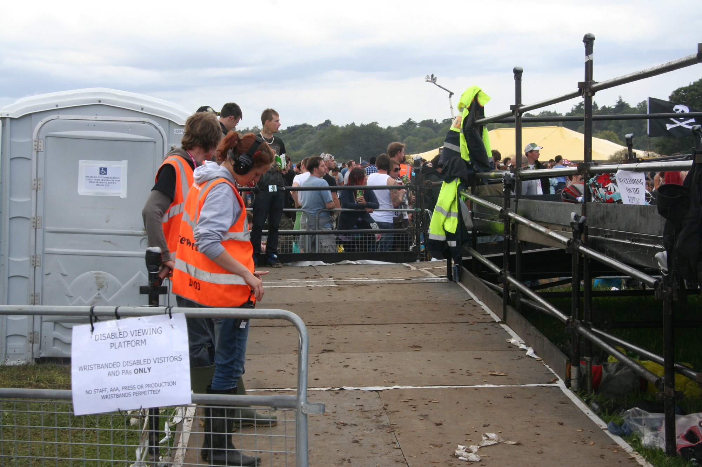
Key Accessible Facilities
Accessible viewing platforms at many festivals
Accessible toilets
Accessible campsites
Notes:
Topic: Accessible Facilities
Associated handouts/resources: none
Facilitator Notes:
Viewing Platforms (VPs)
There are VP’s at the main stages at most festivals.
Anyone wanting to use the platforms must have registered in advance of the festival to do so. They will be issued with VP ID for themselves and for one accompanying person. – Usually a wristband or laminate
All the platforms are stewarded and have charging facilities for electric wheelchairs
Patrons are advised that flicker, laser, strobe and other lighting effects may be in use at the festival site.
Some festivals have BSL interpreters on the VPs

Slide 67
Essential knowledge
The location and nature of access facilities and services on site. i.e. accessible campsite, accessible parking, accessible toilets, viewing platforms and areas, short-cut access routes, hearing loops etc.
How to direct people to access facilities with best access routes in mind
Where Welfare and First Aid are located
Where people can head for information on access to these facilities
Notes:
Topic: Essential Knowledge
Associated handouts/resources: none
Facilitator Notes:
Location and nature of access facilities and services available on-site
How to direct people to these facilities based on their abilities
Welfare
First Aid
Information points

Slide 68
To find out more about the work of Attitude is Everything, please visit: www.attitudeiseverything.org.uk
Notes:
Topic: Attitude is Everything
Associated handouts/resources: none
Facilitator Notes:

Slide 69
Trainers attention test
1
2
3
4
5
6
7
8
9
10
11
12
Notes:
FACILITATORS:
This is to make sure that participants complete all of the training. There are 3 points in the presentation when they need make a note of the picture that’s shown, and then input it as an answer in the evaluation form. This is the first (make a note of which slide you’re used).
This is a navigation slide, designed to help you easily jump around this section of the presentation. In presentation mode, click any numbered square and the presentation will move to that slide. Once you’ve shown the image slide, click the number “1” in the bottom right hand corner to return to this slide.
Explain to participants:
This is an attention test, to make sure you are all still participating in the course
You need to carefully note the image you are seeing as you will need to enter it into the evaluation form using a drop down menu
If your answers are wrong in the evaluation form, you may receive a follow up call from the Steward Coordination Team to discuss

Slide 70
.
Oxfam Stewarding Guide
You will be provided with a digital copy of this before the festival
Keep it on you at all times
Covers the key content from this session
Notes:
Topic: Oxfam Stewarding Guides
Associated handouts/resources: none
Facilitator Notes:
Have a copy to show where possible
There is a lot to take in and remember, but the Steward handbook has been designed to help you during the festival. We will have some paper copies as well as electronic
It contains a summary of this training content.
It is a resource for use during the Festival, not something to browse when you feel like it and forget!
You should have it with you when on shift, the information is relevant and will be useful. Designed to fit easily in a pocket. There are also pages for notes (incidents etc)
Useful to jog your memory or check facts – fire extinguishers, recovery position, radio alphabet etc etc

Slide 71
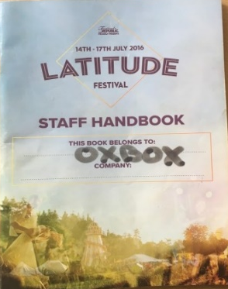
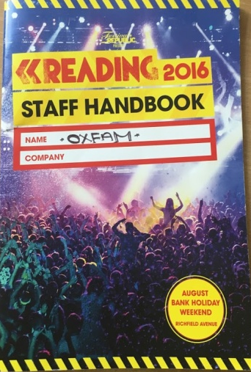
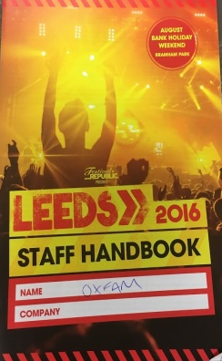
.
Festival Handbooks
Some festivals will supply a staff handbook
Keep this with you at all times
Contains key information for the festival, opening times, wristband types etc.
Notes:
Topic: Festival Staff Handbooks
Associated handouts/resources: none
Facilitator Notes:
Some festivals give these to staff but not all festivals and maybe not all staff

Slide 72
What next?
2027
festivals@oxfam.org.uk
Notes:
Topic: What Next?
Associated handouts/resources: none
Facilitator Notes:
Your training is valid for four years so you won’t need to train again until 2026
Firm up your travel plans on liftshare
Join the Oxfam Festivals Chat fb group
Receive your pre-fest email a couple of weeks before each festival
If you’re not already doing two or more, add another festival to get priority access for applications next year
If you want to give supervising a go then log in and update your profile
If you need to make any changes, or have any further questions, email the office or call on 0300 200 1266

Slide 73
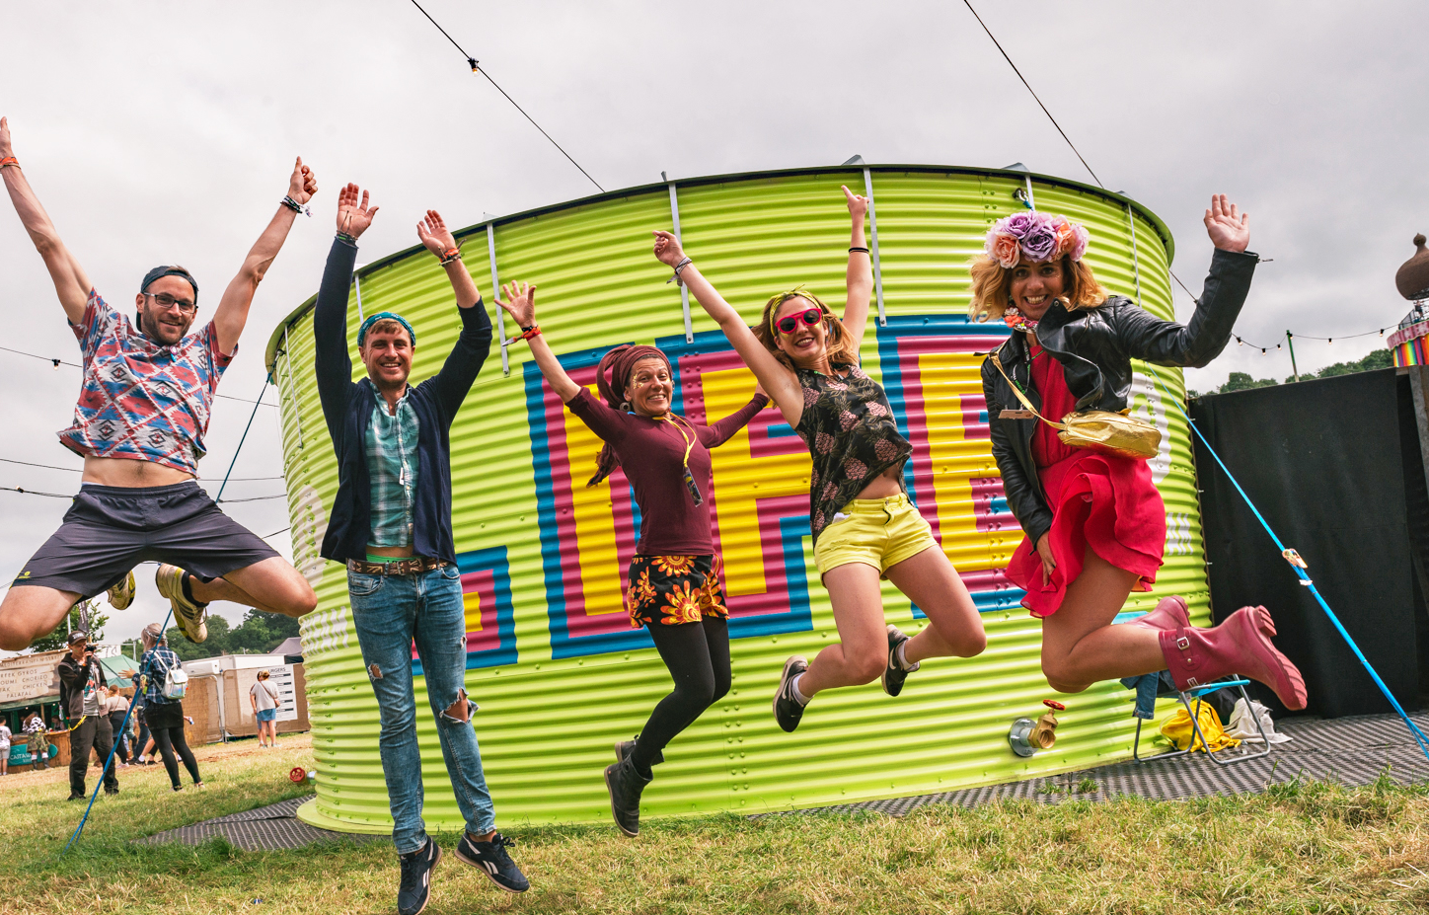
THANK YOU AND SEE YOU ON-SITE!
Please complete your appraisal questionnaire
Thank you for being a part of an exciting 2022 season
Notes:
Topic: Thank you!
Associated handouts/resources: none
Facilitator Notes:
Let everyone know that their application will update to show training completed within 7 days of this session.

Slide 74
Promoting safety at festivals
Festival Safe: https://www.festivalsafe.com
Safe Gigs for Women: https://sgfw.org.uk
White Ribbon: https://www.whiteribbon.org.uk
Girls Against: http://girlsagainst.org.uk
Association of Independent Festivals: https://aiforg.com/initiatives/saferspacesatfestivals
Notes:
Topic: Promoting Safety
Associated handouts/resources: none
Facilitator Notes:
This slide moved to the end so it can be displayed for anybody who wants to note down any of the orgs listed
Festival Safe
Safe Gigs for Women
Safe gigs for women is an initiative established by regular gig goers with the aim of creating a safer environment for women at gigs.
White Ribbon
The White Ribbon Campaign offers real, practical support to help festivals and music venues stop violence against women and girls. The goal is for all women to know they can attend music events with confidence. And to encourage men (customers, staff, performers) to take a stand. Because everyone, male and female, should be able to enjoy music events free from fear.
Girls Against
Girls Against is a campaign working to raise awareness of, and ultimately end, sexual harassment at gigs and concerts.
The Association of Independent Festivals:
National trade organisation The Association of Independent Festivals (AIF) is the UK’s leading festival representative body. Founded in 2008 by Rob Da Bank (Bestival) and his Manager Ben Turner (Graphite Media), the AIF has grown to be a vital support network for independent festivals promoters, creating a national network of promoters, offering a range of member services, lobbying on behalf of the sector and producing conferences and training events. AIF introduced the safer spaces campaign at festivals.

Slide 75
Trainers attention test slides

Slide 76
Hot Air Balloons
1
2
3
Notes:
Hot Air Balloons

Slide 77
Lion
1
2
3
Notes:
Lion

Slide 78
Combine Harvester
1
2
3
Notes:
Combine Harvester

Slide 79
Wellies/Boots
1
2
3
Notes:
Wellies/Boots

Slide 80
Kitten
1
2
3
Notes:
Kitten

Slide 81
Mountain top
1
2
3
Notes:
Mountain Top

Slide 82
Telephone
1
2
3
Notes:
Telephone

Slide 83
Sunflower
1
2
3
Notes:
Sunflower

Slide 84
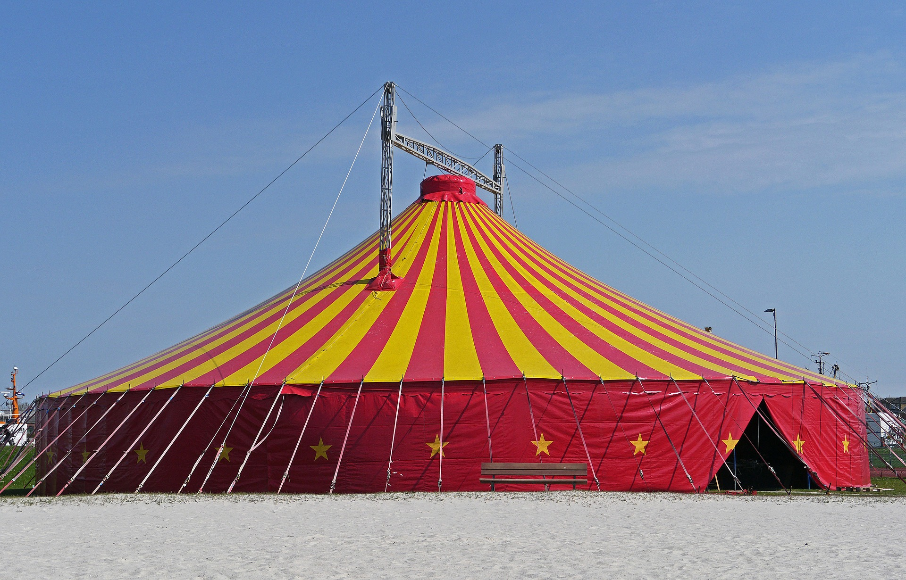
Circus tent
1
2
3
Notes:
Circus Tent

Slide 85
Lightning
1
2
3
Notes:
Lightning

Slide 86
Chocolate
1
2
3
Notes:
Chocolate

Slide 87
Cow
1
2
3
Notes:
Cow

